Slide 1
Group Case Study on Affordable Care Act signed by B. Obama in 2010.
By Basanskaya Sasha, Klimova Anna, Orekhova Angelina

Slide 2
November 2009 - The Affordable Health Care for America Act (House of Representatives) December 2009 - an alternative health care bill, the Patient Protection and Affordable Care Act (The Senate ) In 2010, the House abandoned its reform bill in favor of amending the Senate bill
President Obama addressing Congress regarding healthcare reform, September 9, 2009

Slide 3
The Patient Protection and Affordable Care Act signed in 2010 imposes a health insurance mandate
In 2010, a number of states joined litigation in federal court arguing that Congress did not have the power to pass this law and that power to "regulate" commerce does not include an affirmative power to compel commerce by penalizing inaction

Slide 4
The Affordable Care Act Consumer Rights and Protections
End to Pre-Existing Condition Discrimination
End to Limits on Care
End to Coverage Cancellations
More Affordable Coverage
Value for Your Premium Dollar
Strengthening Review of Rate Increases
Help Paying for Premiums:
Improving Affordability

Slide 5
Measures which were introduced against insurance companies
. The Affordable Care Act creates a new Patient’s Bill of Rights
Insurers can no longer impose lifetime dollar limits on essential health benefits
Responsible to their customers for how they are spending premium dollars
The participant of the meeting in support of the reform,
2 September, 2009

Slide 6
Provided people 4 different medical plans

Slide 7
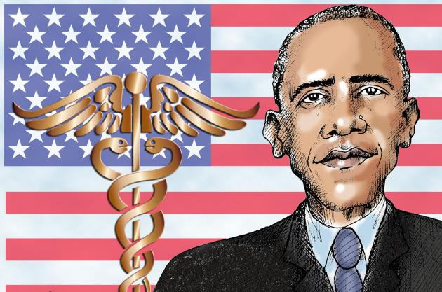
Free prevention benefits
Insurers must cover a number of recommended preventive services, such as cancer, diabetes etc without copays or deductibles.
You can stay on the your parents’ plans until age 26

Slide 8
Strengthening Medicare
Lower-Cost Prescription Drugs
Free Preventive Services
Fighting Fraud
Improving Care Coordination and Quality
Fewer Unnecessary Hospital Readmissions
Lower Premiums

Slide 9
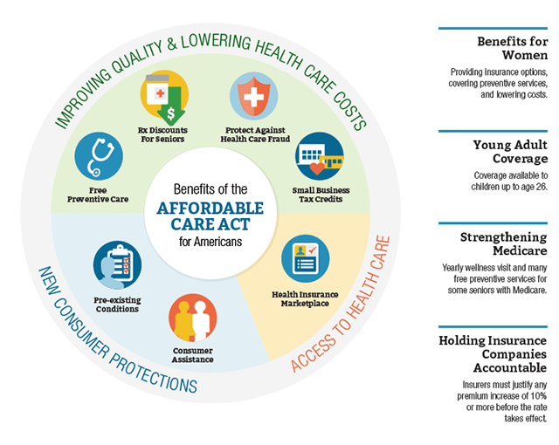

Slide 10
IMPROVING QUALITY AND LOWERING COSTS
Providing Small Business Health Insurance Tax Credits
Providing Free Preventive Care
Preventing Disease and Illness
Cracking Down on Health Care Fraud
Coverage for Young Adults

Slide 12
Links
https://www.whitehouse.gov/healthreform/healthcare-overview#consumer-rights
https://en.wikipedia.org/wiki/Patient_Protection_and_Affordable_Care_Act
https://en.wikipedia.org/wiki/Affordable_Health_Care_for_America_Act
https://www.youtube.com/watch?v=PsrdaS6S-Lg
http://www.coveredca.com/
http://www.hhs.gov/healthcare/facts-and-features/key-features-of-aca-by-year/index.html
Images
https://en.wikipedia.org/wiki/Patient_Protection_and_Affordable_Care_Act#/media/File:111th_Congress_1st_session_Senate_roll_call_396.svg
https://www.whitehouse.gov/healthreform/healthcare-overview#consumer-rights
http://ptzgovorit.ru/sites/default/files/original_nodes/sud_20.jpg
http://ya-online.com/wp-content/uploads/2014/06/11.jpg

