Slide 1
Congress
The House of
Representatives
435 repr.
2-year term
20 committees
The Senate
100
Senators
6-year term
16 commit.

Slide 2
The main function of Congress is
to make laws and create new court system;
to carry out the laws;
to determine whether the actions of the President violate the Constitution
To watch government expenditure.

Slide 3
The Constitution gives the House and Senate essentially similar legislative tasks, though each has powers that are only its own:
1. Only the House has the power of impeachment.
2. The Senate must approve major presidential appointments.
3. The Senate has the sole power to affirm treaties.

Slide 4
Functions of the Committees
Standing committees of the HR: Agriculture; Appropriations; Armed Services; Banking and Financial Services; Budget; Commerce; Education and the Workforce; Government Reform and Oversight; etc.
To enquire into each bill and to recommend whether the bill could be accepted or not
To look into the whole pattern of government expenditure

Slide 5
Committees: the workhorses of Congress
A. Congress has committees for the same reason that any large organization is subdivided into specialized groups or divisions: to develop and use expertise in specific areas.
B. Committee types include standing, joint, select and conference.
C. Influence on committees grows formally with seniority and informally with increased expertise.

Slide 6
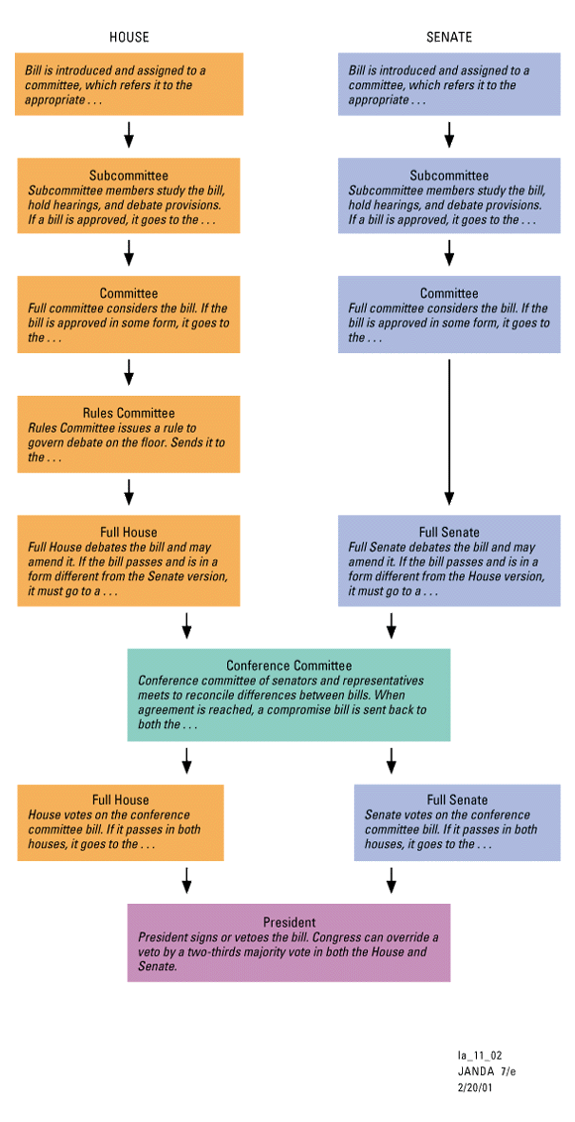

Slide 7
How do legislators make up their minds about how they will vote?
The most important influences seem to be
Political parties
The President
Interest groups

Slide 8
Interest groups and the American political tradition
An interest group can be defined as “an organized body of individuals who share some political goals and try to influence public policy.”
Interest groups play many roles in the American political system such as representation, participation, education, agenda building and program monitoring.
Who is being organized is also an important force affecting group formation.
The wealthy and the well educated are more likely to form and join lobbies

Slide 9
What resources are available to interest groups?
A. One of the most valuable resources a group can have is a large and politically active membership.
B. Lobbyists can be either full-time employees of the organization or hired from law firms or public relations firms.
C. Political action committees (PACs) pool contributions from group members and donate those funds to candidates for office.

Slide 10
Lobbying Tactics
A. In direct lobbying, a group’s representatives have direct contact with a policymaker.
B. In grassroots lobbying, an interest group’s rank-and-file members, and possibly others outside the organization, try to influence government on some issue.
C. Information campaigns are organized efforts to gain public backing by bringing the group’s views to the public’s attention.

Slide 11
Interest Groups and Bias
A. Lobbying can be evaluated through both the pluralist and majoritarian frameworks.
1. Evaluating fairness in the pluralist framework requires that we take account of significant interests in the population.
2. The interest group system is tempered by the majoritarianism of elections: the party that wins an election will have more say than its opponent in granting interest groups access, and thus in giving them a voice in policymaking.
B. Since elections are majoritarian, the party in power tends to have more say in policymaking.

Slide 12
Electing Congress
A. Incumbents have a very high rate of return to Congress.
B. Incumbents remain protected by district lines that are gerrymandered to protect incumbents or the dominant party.
D. The members of Congress are not representative of the U.S. population in terms of demographics.
All members of Congress live in two worlds. In Washington they spend time dealing with the great issues of national concern. But they also spend much of their time traveling back to their district or state, where they meet with constituents and give speeches to local groups.

Slide 13
The oversight powers of Congress
To prevent waste and fraud;
To protect civil liberties and individual rights;
To ensure executive compliance with the law;
To gather information for making laws and educating the public;
to evaluate executive performance.

Slide 14
Congress's oversight functions take many forms:
Committee inquiries and hearings;
Formal consultations with and reports from the president;
Senate advice and consent for presidential nominations and for treaties;
House impeachment proceedings and subsequent Senate trials;
House and Senate proceedings under the 25 Amendment in the event that the president becomes disabled, or the office of the vice president falls vacant;
Informal meetings between legislators and executive officials

Slide 15
The power of Сongress to watch the other two branches is called:
The power of oversight review
The power of judicial review
The power of exclusive review

Slide 16
Federalism
Federalism according to founding fathers is based on: A. absolute sovereignty for the states and concurrent powers B. “residual sovereignty” and concrete powers C. residual sovereignty and concurrent powers

Slide 17
Which of the following are not concurrent powers:
Tax and collect taxes
Make and enforce laws
Conduct foreign affairs

Slide 18
The system of checks and balances helps:
to avoid the tyranny of concentrated power
to debate and vote bills
to specify the powers and duties of each branch of government

Slide 19
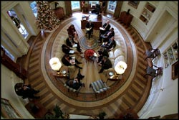
The Executive Branch
It is responsible for administering the laws passed by Congress

Slide 20
In the US, the president and legislature are elected separately, housed separately, they operate separately – separation of powers.
In the parliamentary systems that operate in most western democracies, the national leader is chosen by the parliament.

Slide 21
THE PRESIDENCY
Term of Office: Elected by the people, through the electoral college, to a four-year term; limited to two terms. Salary: $400,000 per year as of January 20, 2010.
Inauguration: January 20, following the November general election.
Qualifications: Native-born American citizen, at least 35 years old, and at least 14 years a resident of the United States.
Chief Duty: To protect the Constitution and enforce the laws made by the Congress.

Slide 22
The Expansion of presidential power
A. The power of the modern presidency comes not only from the explicit powers listed in the Constitution but also from the expansion of authority under claims of inherent powers.
B. Congress has also delegated power to the executive branch.
C. Presidential power is determined in part by the political skills of the individual president.
D. Presidents are in a better position to bargain when their public popularity is high.

Slide 23
The executive branch establishment
The most important president’s resources in office is his White House staff.
Vice presidents have traditionally been “standby equipment.” - Al Gore was given a more public role than usual, and Dick Cheney was a major force within the George W. Bush administration.
The cabinet is composed of the heads of the major departments in the executive branch and a small number of other key officials.

Slide 24
15 departments in the executive branch:
Secretary of State Department of State (1789): Works with other countries.
Secretary of the Treasury Department of the Treasury (1789): Supervises the collection of taxes and the printing of money.
Secretary of Defense Department of Defense (1947): Oversees the armed forces.
Attorney General Department of Justice (1870): Enforces the U.S. Government's laws.

Slide 25
Departments of the Cabinet.
Department of the Interior (1849) Department of Agriculture (1862)
Department of Commerce (1903) Department of Labor (1913) Department of Health and Human Services (1953) Department of Housing and Urban Development (1965) Department of Transportation (1966) Department of Energy (1977)
Department of Education (1979) Department of Veterans Affairs (1988) Department of Homeland Security (2003)

Slide 26
The powers of the President as the National Leader
to call special sessions of the Congress;
to recommend legislation to the Congress;
to deliver messages to the Congress;
to sign or veto legislation;
to appoint federal judges;
to appoint heads of federal departments and agencies and other principal federal officials.

Slide 27
The powers of the President as the World leader
to appoint representatives to foreign countries;
to carry on official business with foreign nations;
to exercise the function of commander-in-chief of the armed forces;
to grant pardons for offenses against the United States.

Slide 28
How powerful is the President?
Congress has the power to make laws, but the President may veto any act of Congress.
Congress, in its turn, can override a veto by a two-thirds vote in each House.
Congress can also refuse to provide funds requested by the President.
The HR controls spending and finance, so the President must have its agreement for his proposals and programs.
The President can appoint officials of his administration, all federal judges but they must be approved by the Senate.

Slide 29
How powerful is the President?
The President can not declare war without the approval of Congress.
Any treatment in foreign affairs first must be approved by the Senate.
The courts have the power to determine the constitutionality of all acts of Congress and of presidential actions.
The President negotiates treaties with foreign countries, but the Senate must approve them.

Slide 30
On December 8, 2009, the White House issued an unprecedented Open Government Directive
The Administration is reducing the influence of special interests by writing new ethics rules that prevent lobbyists from coming to work in government or sitting on its advisory boards.
The Administration is tracking how government uses the money with which the people have entrusted it with easy-to-understand websites like recovery.gov, USASpending.gov, and IT.usaspending.gov.

Slide 31
The President and the Executive Branch The Judicial Process Using E-government: Effect of Digital Revolution

Slide 32
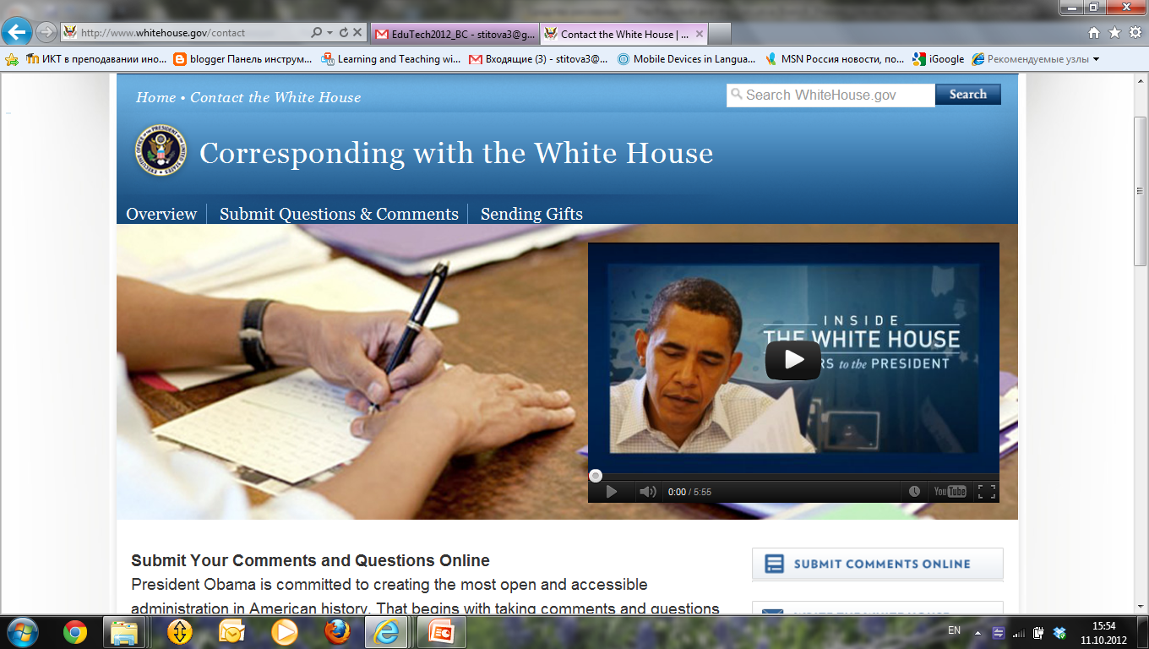
E-Government can be defined
as delivery of
public information,
goods,
services through the use of ICT

Slide 33
E-Government is digital interactions between
government and citizens (G2C),
government and businesses/Commerce (G2B),
government and employees (G2E),
government and governments /agencies (G2G).

Slide 34
Traditional ways of interaction
U.S. Governments
Governmental sites
President’s site, blog, Twitter, YouTube,
Social bookmarking, mobile applications,
SMS,E-mail
U.S. Citizens

Slide 35
What does e-government result in?

Slide 36
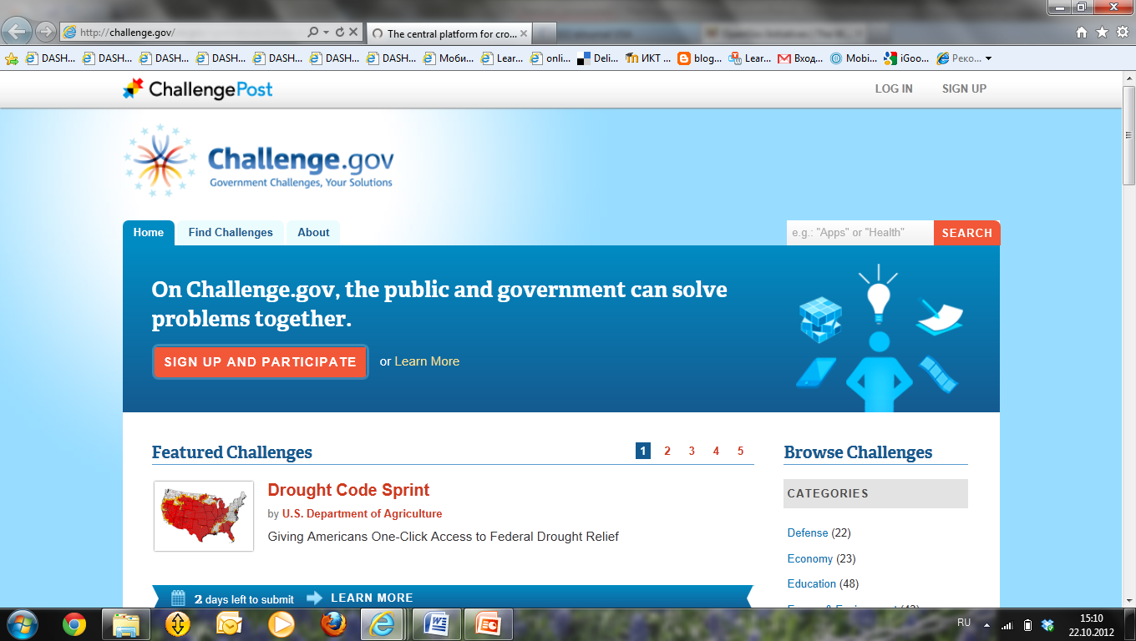
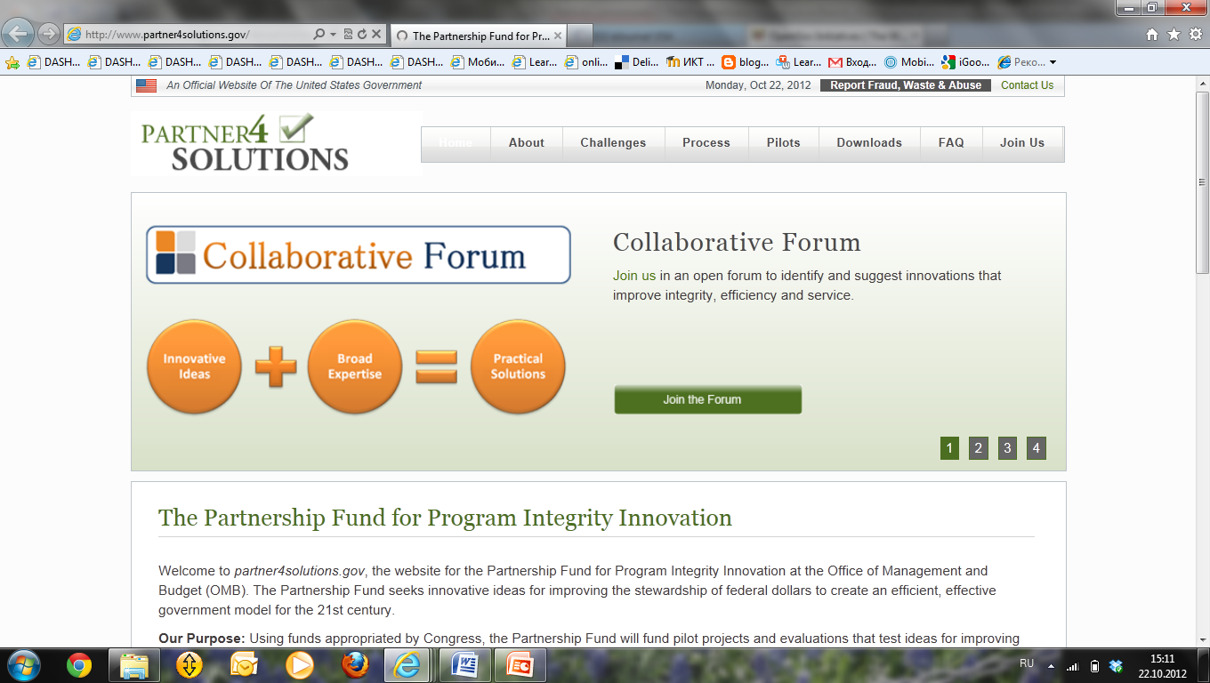
Citizen Engagement

Slide 37
Ways to get in touch with citizens

Slide 38
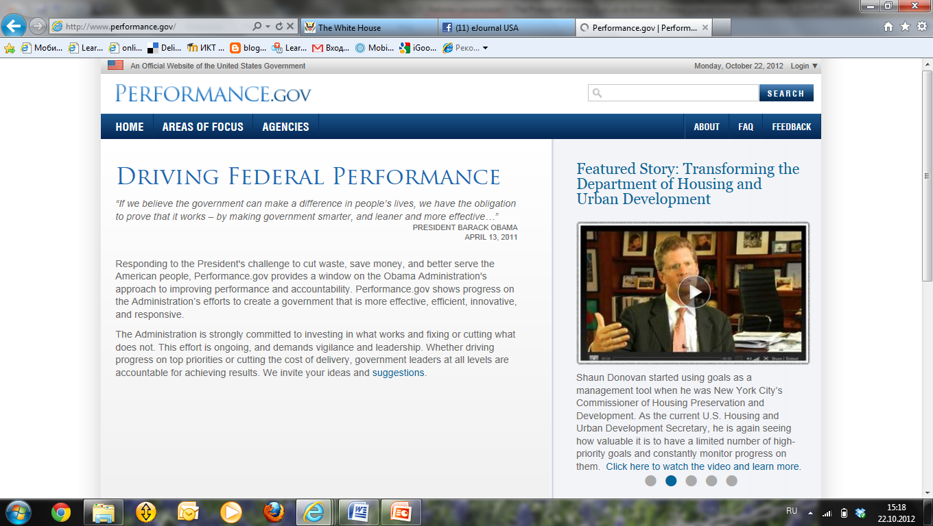
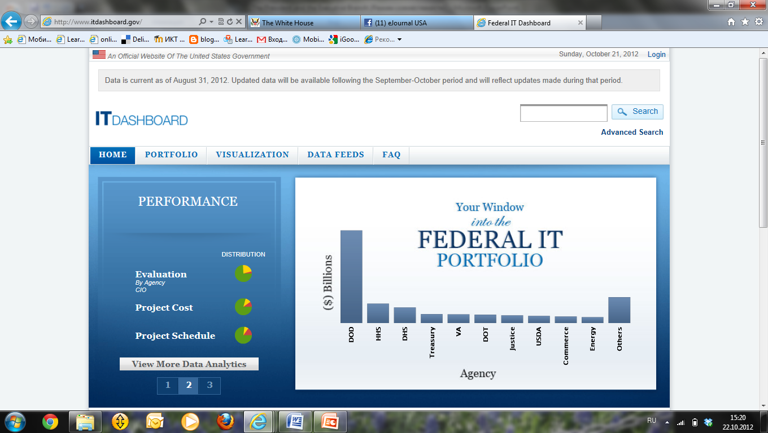
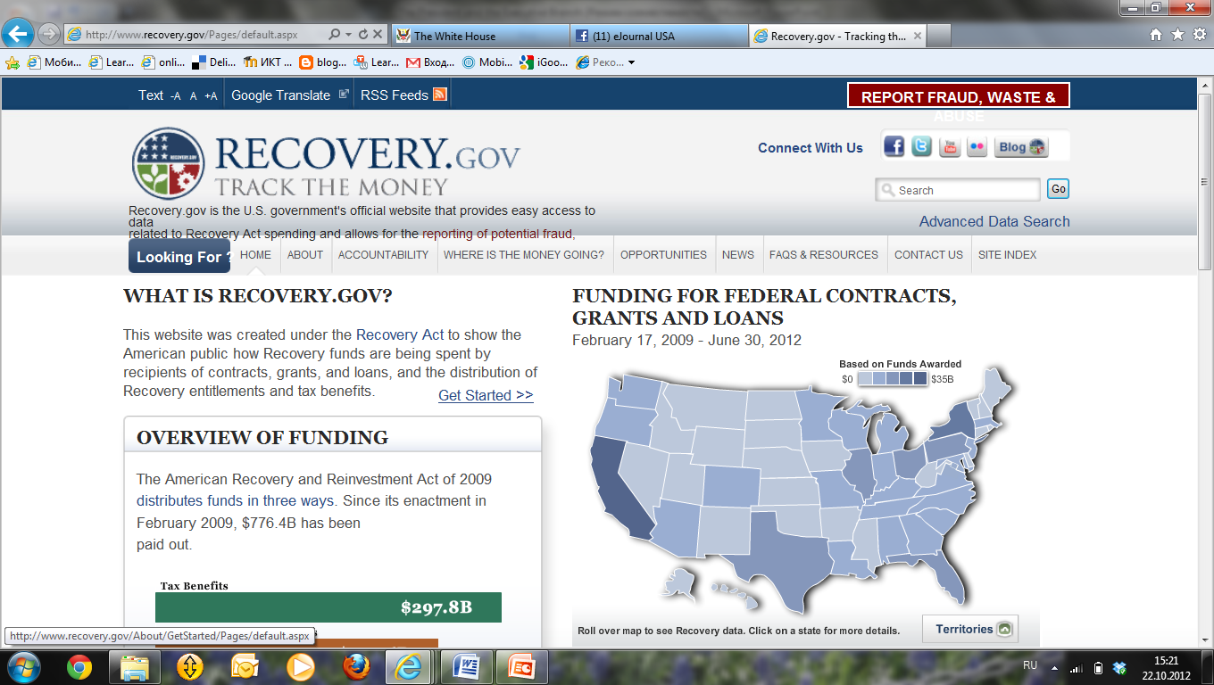
Performance and Accountability of the government

Slide 39
http://www.whitehouse.gov/contact

Slide 40
E-Services for citizens http://www.egov.com/Pages/default.aspx

Slide 41
Citizen Services
Benefits.gov
Business.gov
DisasterAssistance.gov
GovLoans.gov
Grants.gov
Healthcare.gov
USA.gov

Slide 42
Federal Acts on e-government
The E-Government Act of 2002
Government Paperwork Elimination Act of 1998 (GPEA)
Clinger-Cohen Act of 1996
Federal Acquisition Streamlining Act of 1994, Title V (FASA V)
Government Performance Results Act of 1993 (GPRA)

Slide 43
The E-Government Act of 2002
Title I: Office of Management and Budget Electronic Government Services - Establishes in the Office of Management and Budget an Office of Electronic Government, headed by an Administrator appointed by the President
Title II: Federal Management and Promotion of Electronic Government Services
Title III: Information Security - Requires the Director of OMB to oversee agency information security policies and practices

Slide 44
Digital Government Strategy in 21 century
“I want us to ask ourselves every day, how are we using technology to make a real difference in people’s lives.” – President Barack Obama
Digital Government Strategy in 21 century http://www.whitehouse.gov/sites/default/files/omb/egov/digital-government/digital-government.html

Slide 45
White House http://www.whitehouse.gov/omb/e-gov

Slide 46
Texas.gov Honored for eGovernment Excellence in 2012 http://www.texas.gov/en/Pages/default.aspx
Best of Web – Texas.gov was named a top 10 finalist by the Center for Digital Government for the third straight year
Noteworthy accomplishments for Texas.gov in 2012 included the launch of a mobile site, m.texas.gov
Interactive Media Awards (IMA) –Texas.gov/Driver, a specialized landing page that serves as a convenient, user-centered resource for Texans to access driver-related information and online services

Slide 47
Samples of e-government sites
CIO.gov Blogs
Our Nation's First Federal CIO
E-Gov Accomplishments
Data.gov Celebrates its Second Birthday

Slide 48
Webliography
Edwards, George C. Government in America: People. Politics, and Policy. 10th ed. New York, New York: Longman, 2008
Wilson, James American Government: Institutions and Policies. 7th ed. Boston, Houghton Mifflin, 1998.
http://bensguide.gpo.gov/9-12/government/state/index.html
http://www2.census.gov/geo/maps/general_ref/cousub_outline/cen2k_pgsz/pa_cosub.pdf
http://www.usa.gov/
http://www.whitehouse.gov/

Slide 49
Terms to know
Impeachment
Bill
Interest groups
Political action committees (PACs)
oversight powers of Congress
Incumbents
Incumbency effect

