Slide 1
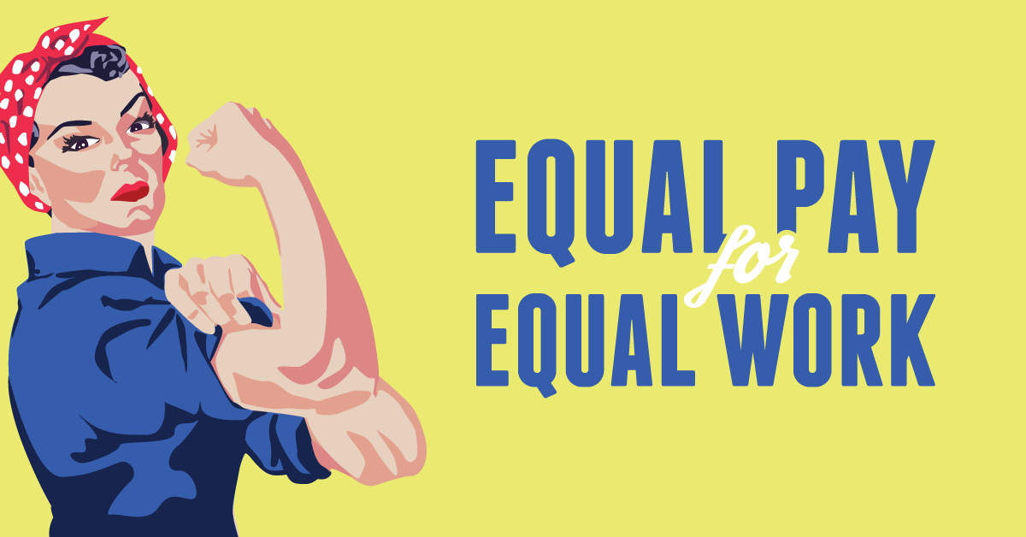
National Equal Pay Task Force: 2010 and beyond
Sasha Basanskaya
Anna Klimova
Angelina Orekhova

Slide 2
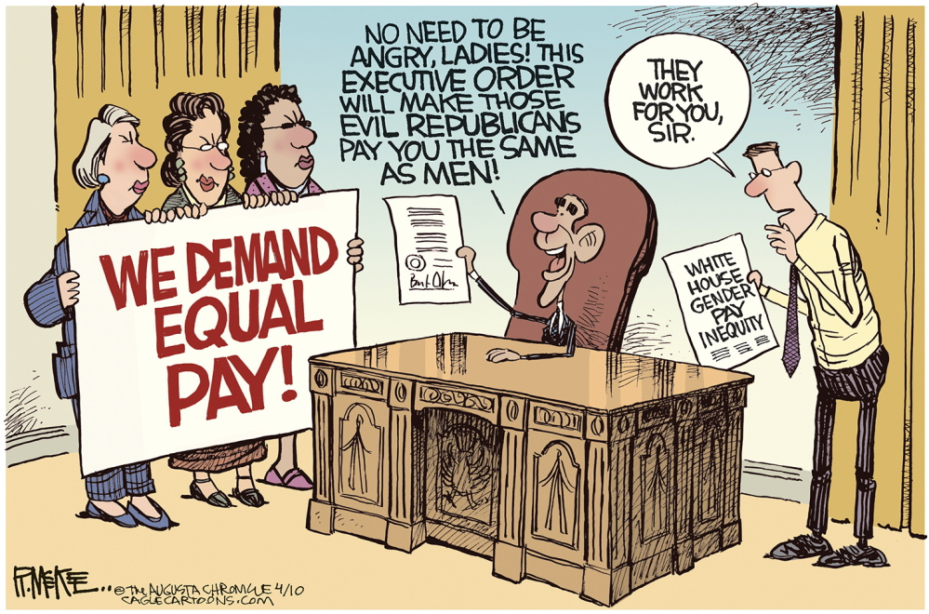
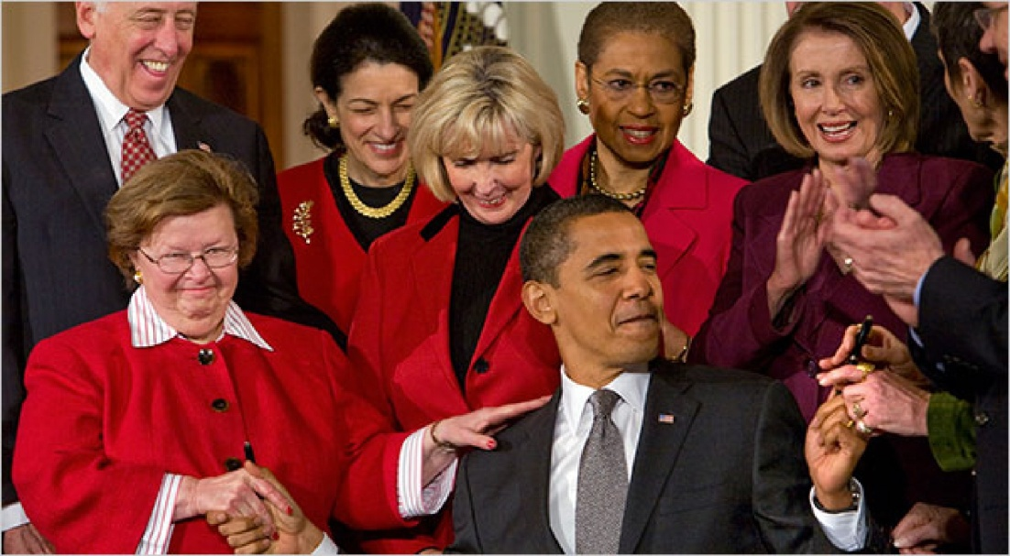
There are multiple ways to measure the pay gap – but under all of them, and with or without considering occupation, female and minority workers earn significantly less than White male workers
According to the latest Bureau of Labor Statistics data, women’s weekly median earnings are about 81 percent of men’s dollar
Equal pay will provide a broader economic base for the American nation

Slide 3
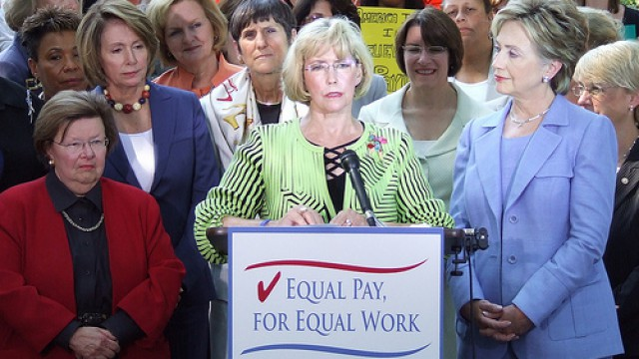
Women continue to lead in educational attainment
Despite these gains, the workforce continues to be segregated by race and gender
In recent decades, two areas that historically were almost exclusively male – the STEM fields and the military – have begun to open to women.

Slide 4
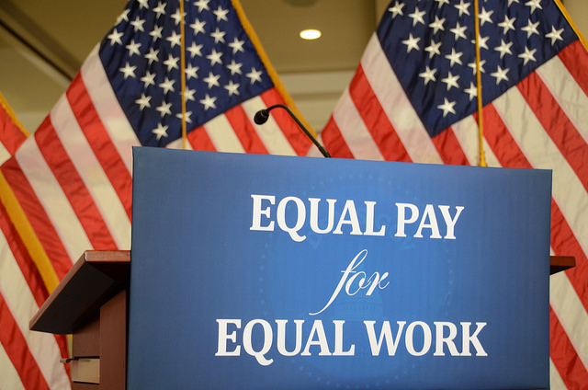
Occupational segregation fuels the wage gap because average wages in “female” occupations are lower, even holding constant other observable characteristics such as education.
The pay gap exists for women with advanced degrees, corporate positions, and high--‐paying and high-skill jobs, just as it does for low- and middle-income workers.

Slide 5
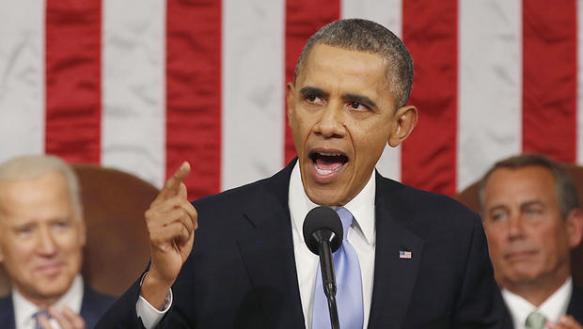
Closing the Gap – The Way Forward
Pr. Obama pledged to crack down on violations of equal pay laws
The White House announced the creation of a NEPTF which brings the expertise an dresources of 4 federal agencies:
EEOC
DOJ
DOL
OPM

Slide 6
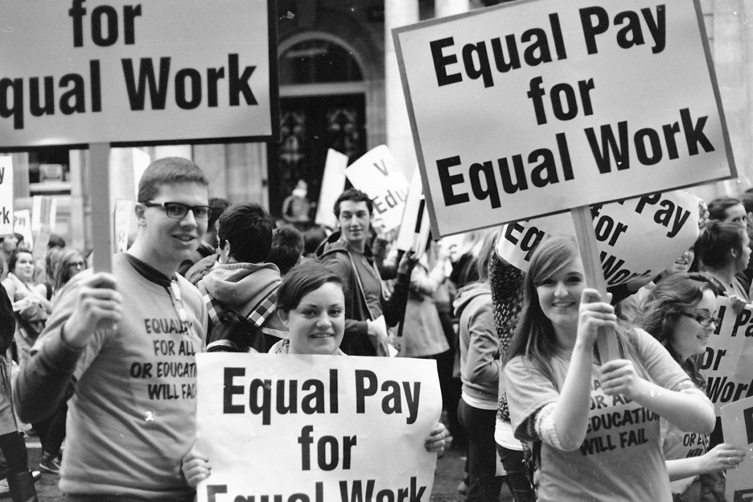
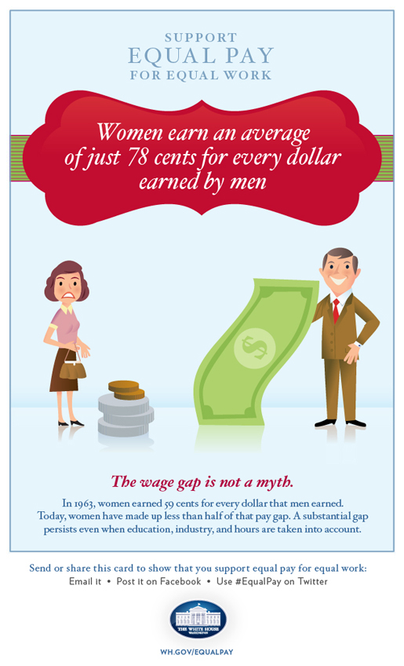
Achievements of the National Equal Pay Task Force
recommendations:
Interagency Coordination
Available Data Sources
Outreach and Public Education
Passage of the Paycheck Fairness Act

Slide 7
Establishing the Infrastructure for Improved Equal Pay Enforcement
The infrastructure development was based on two pillars:
the development of mechanisms for interagency collaboration.
efforts to ensure federal regulations and to provide a framework for the enforcement of equal pay laws.

Slide 8
The cooperation
EEOC - The U.S. Equal Employment Opportunity Commission
OFCCP - the Office of Federal Contract Compliance Programs
DOJ - The United States Department of Justice
United States Women's Bureau
The Civil Rights Bureau

Slide 9
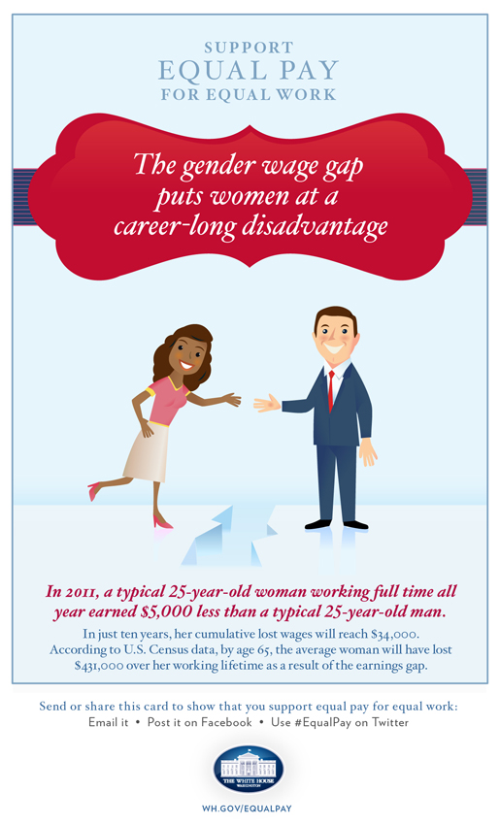
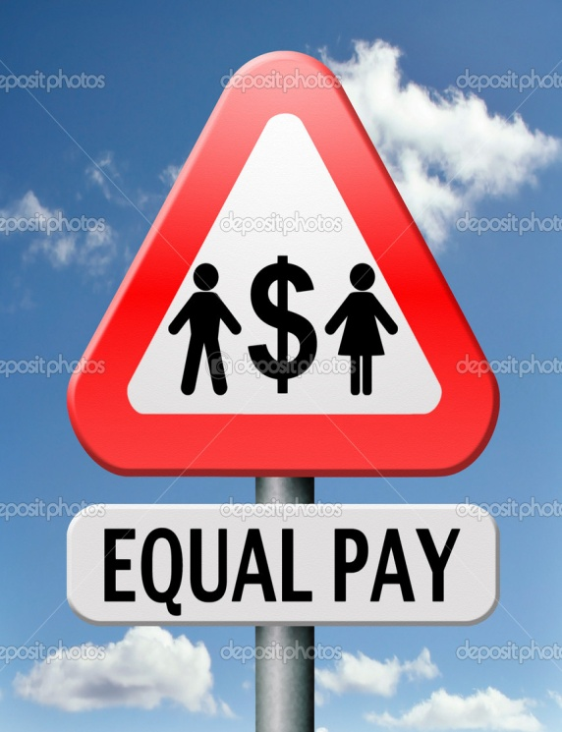
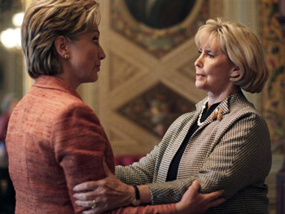
2013 and Beyond: The Way Forward
regular meetings to ensure information sharing between agencies
many women do not know they are being underpaid and many employers prohibit sharing of pay data
the DOJ has focused on cases that open non-traditional positions where women are excluded from higher paying job opportunities

Slide 10
Closing the gap
Closing the gap could have broad benefits for:
reducing poverty
growing the middle class
boosting the nation’s economic growth

Slide 11
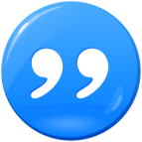
The task force report:
«Workers should know their worth and be empowered to claim it. Federal agencies should safeguard the right to equal pay and make certain all employers play by the same rules. Employers should share best practices for providing equal opportunity in the workplace».

Slide 12
http://www.lifeofthelaw.org/2014/02/how-an-obscure-quirk-of-equal-pay-laws-causes-some-women-to-miss-out/

Slide 13
LINKS
Information:
https://m.whitehouse.gov/issues/equal-pay
https://en.m.wikipedia.org/wiki/Equal_pay_for_equal_work
http://www.eeoc.gov/laws/types/equalcompensation.cfm
Images:
https://www.whitehouse.gov/sites/default/files/docs/equal_pay_issue_brief_final.pdf
http://www.mylearning.org/womens-rights--the-equal-pay-debate/images/2-915/
http://iipdigital.usembassy.gov/st/english/inbrief/2013/06/20130610275798.html
https://www.wyden.senate.gov/news/blog/post/equal-pay-for-equal-work_its-a-no-brainer
http://womenmisbehavin.com/category/equal-pay-day-2/

